Slide 1
Interesting Facts About Walt Disney You didn’t Know.

Slide 2
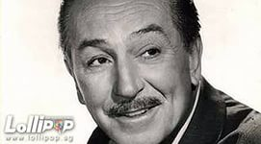
Aged 16, Walt signed up for the army, but was rejected because he was too young. Instead he became an ambulance driver in World War I France.

Slide 3
“Man is in the forest” was a code used by animators to warn colleagues to get back to work when Walt Disney was coming down the hallway.

Slide 4
It's rumoured that Walt Disney had a phobia of mice. While this is hard to prove, it is a fact that his big-eared creation was named 'Mortimer', until his wife persuaded him that 'Mickey' had a better ring to it…

Slide 5
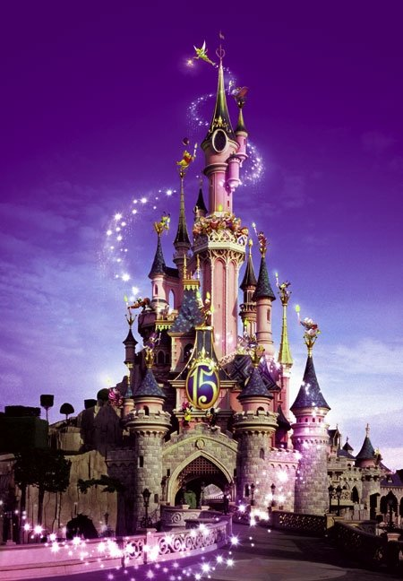
The Disney World resort is about the same size as San Francisco.

Slide 6
Walt Disney's attention to detail was legendary. He placed the bins at Disney World 25 steps away from the hot dog stall, as this was how long it took him to eat a hot dog.

Slide 7
Lots of early Disney films are a mother-free zone: The Jungle Book, Pinocchio and - sob - Bambi. It's been suggested that this was because of their creator's guilt over the death of his own mother in 1938. Fresh from the success of Snow White, he had bought a home for his parents, but tragically a faulty heating system led to Flora Disney's death from carbon monoxide poisoning.

Slide 8
Disneyland, California, was built in the early 1950s, opening in 1955. Anxious to be on site as much as possible, Walt built an apartment for his family above the 'Fire Department' on Main Street. A lamp in the window signaled to staff that he was in residence, and this is now always alight in his honour.

Slide 9
Bruce, the 'vegetarian' great white shark of Finding Nemo, was named after the mechanical shark used in Jaws, which, in turn, was named after Steven Spielberg's lawyer!

Slide 10
Mickey Mouse was the first animated character to receive a star on the Hollywood Walk of Fame. We imagine he'd rather have had a cheese wheel, but you can't always get what you want.

Slide 11
Walt's final words - written rather than spoken - were, rather cryptically 'Kurt Russell'. No one, including the actor himself, has any idea why.

Slide 12
